Slide 1
ACT New Home

Slide 2
four ELEMENTS_about us
Social Actor &
a Leading institution in the Mediterranean area
Non Profit & Non Governmental Organization with international activity
Certified and supervised by the Ministry of Foreign Affairs
Certified and supervised by the Ministry of Health

Slide 3
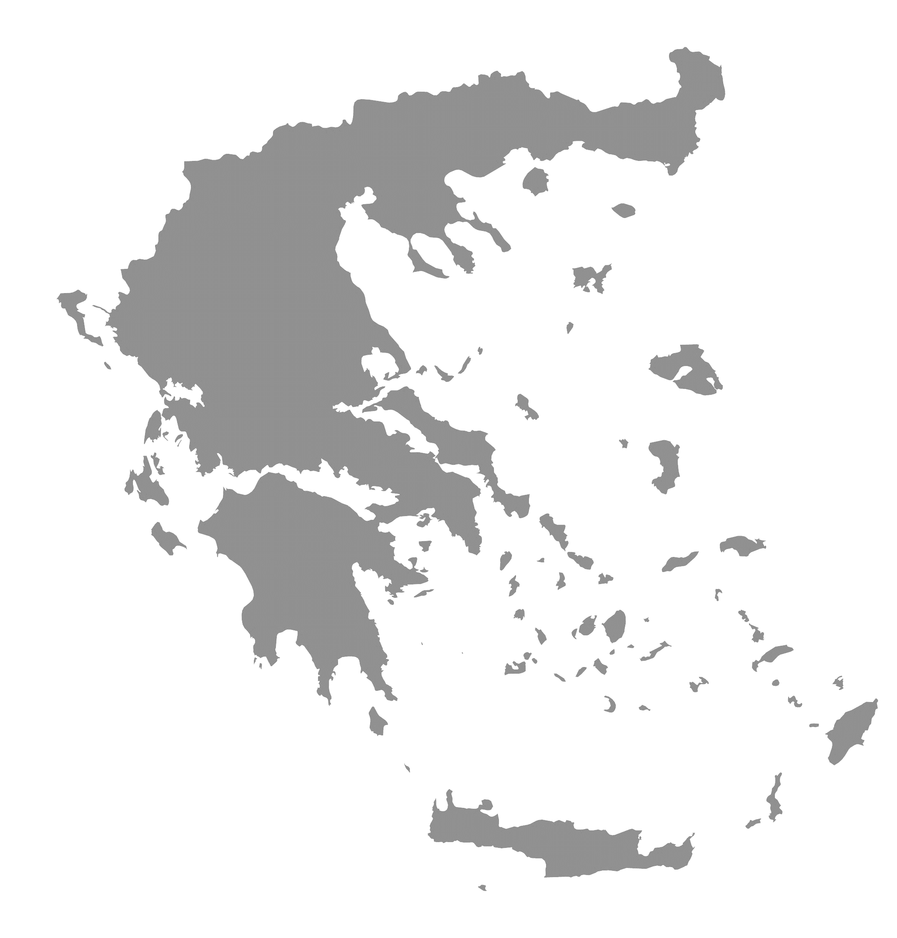
four ELEMENTS_about us
Drama
Thessaloniki
Giannena
Patra
Athens
Kalamata
Heraklion
We are based in Athens and we have
a total of 7 structures all over Greece

Slide 4
four ELEMENTS_about us
We are well equipped and use state-of-the-art technological tools
seminar rooms, IT laboratories, specialized equipment for disabled people, libraries with internet access & counseling center
Our team is well informed about new advances in the digital and environmental field
we have a body of 12 registered volunteers ready to support our activities

Slide 5
the four elements
of our action
that defined
our name are:
01
VULNERABLE GROUPS
02
EDUCATION
03
HEALTH & SOCIAL CARE
04
GREEN ECONOMY

Slide 6
Our Vision & Approach
Solve people problems
(among vulnerable groups, unemployed, women, disabled, children, refugees etc.)
We implement research, consulting, training and upskilling in
the green and digital transition
Raise awareness of social issues in Greece, EU and worldwide
And the way to achieve it is by
working with professionalism and consistency
Build up long-term relations of cooperation based on mutual trust and respect of our partner’s uniqueness

Slide 7
Our Values
Equality and Diversity
Respect for others and Fairness
Community Involvement
Sustainability

Slide 8
Meet Our Team
Experienced consultants
Researchers
& IT experts
Project managers
.
Volunteers

Slide 9
Main Target Groups
Long-term unemployed and those with low professional qualifications
People with physical disabilities and mental disorders
Elderly
Children at risk of trafficking and exploitation
Immigrants and refugees
Women and especially women in difficult situations

Slide 10
Our course
Big number of national and international projects
Various activities in support of foreigners, refugees and immigrants coming to Greece
Consulting youngsters and vulnerable groups
in Greece
Keep working, researching and supporting our target group..
Expanding our activities and collaborators all over Greece
Starting implementing EU funded projects
2019
2014
2022
2007
2016
2011

Slide 11
Four ELEMENTS
has developed a wide network of partners
both from Greece
and abroad
Our Network
Social Actors
Public Authorities
Policy Makers
Universities
SMEs
Clusters
Research Centers
Certification Bodies

Slide 12
Indicative projects
Volunteering Among Immigrants - VAI
COME IN – COMpetences in Enterprises on INtegration

Slide 13
Indicative projects
Refugee Employment Support and Training - REST
mutual Learning for Intercultural ApprecIation and Strengthened Organisational Networks - LIAISON

Slide 14
Our role in the project
Four elements will contribute to all stages of the project
In particular
We will conduct "Experience Sharing Workshops" to collect data for the creation of the 'Active Citizenship for Asylum Seekers and Refugees' module.
Four Elements is responsible for the technical design and creation of the online tool and transfer of the E-learning module to the web platform.
According to the feedback from the pilot application our team will give the e-learning module its final shape and have it accessible to all.
In addition, Four Elements will be responsible for the preparation of the online meeting minutes.

Slide 15
THANK YOU
www.4-elements.org

